Slide 1
Take a Tour in Tactical Boots
Pre/Post Activities

Slide 2
Pre-Activity

Slide 3
How would you characterize these geographical regions?
Europe/North Africa
Dry in North Africa, with geography consisting of mountains and desert
Temperate climate in Europe; mountainous in South, forests and plains in the North
Japan/Pacific Islands
Philippines are tropical and generally wetlands
Japan is tropical and temperate; combination of mountainous and wetlands, dependent on island
Vietnam
Humid subtropical climates, with some mountains and dense forests
Consider how these climates and physical geographical characteristics might influence military uniforms

Slide 4
Post Activity

Slide 5
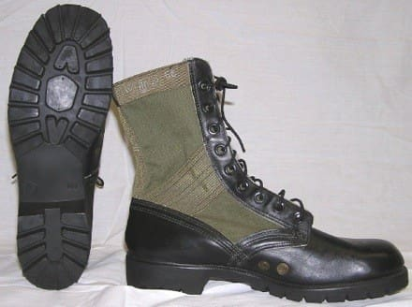
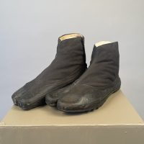
Which boots are associated with the Vietnam War?
Rigid shape is better for wet environments
Relaxed shape would struggle to keep dry, uncomfortable

Slide 6
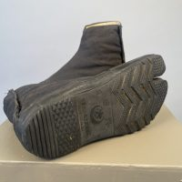
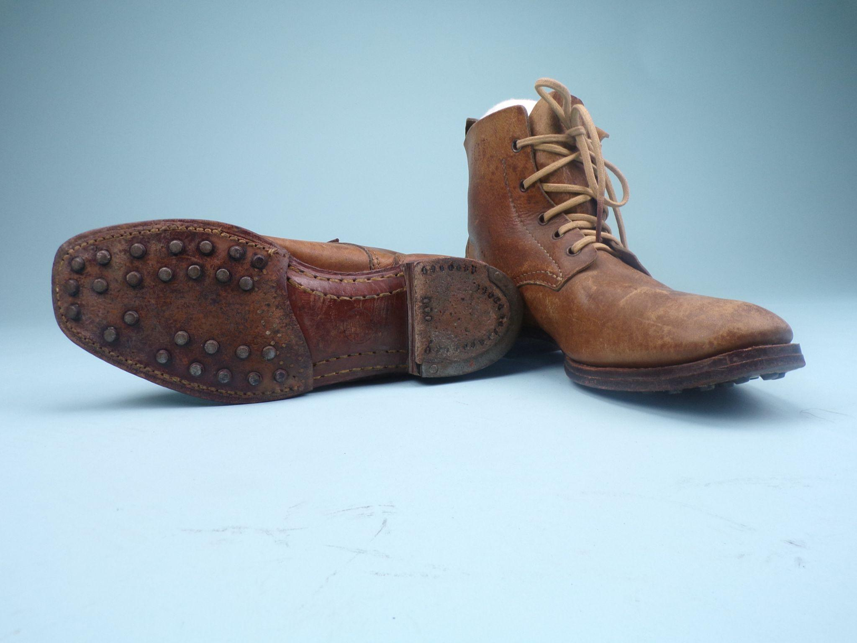
Which of these Japanese boots were the primary boots of a soldier’s kit?
Used only during warmer months, and easily stored in bags
Durability and versatility kept these as main boots

Slide 7
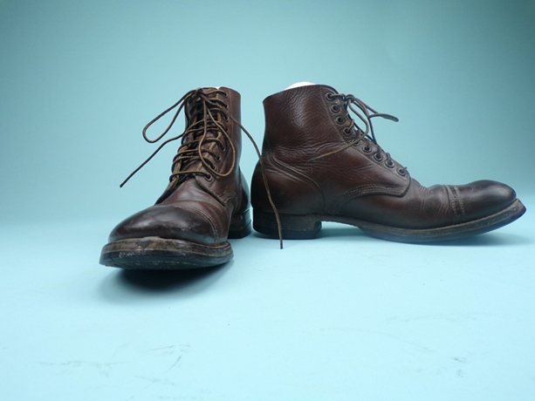
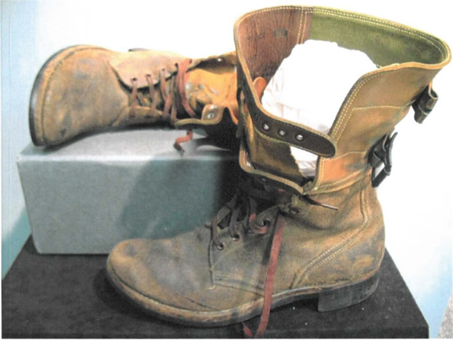
Which military conflict do these boots align with?
WW2 European Theater
Compared to the other boots, these are made of harder leather with no mesh, which would be uncomfortable in tropical climates in the Pacific region

Slide 8
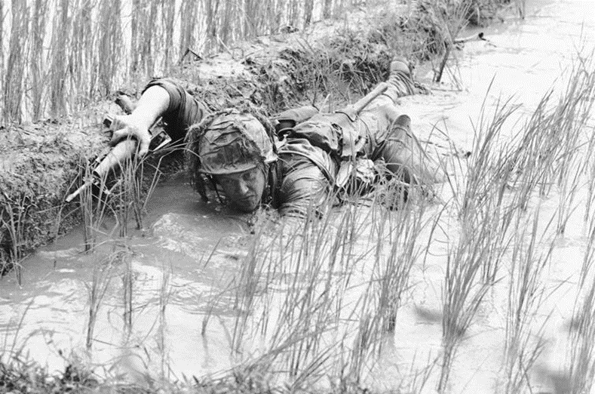
What conflict is this photo from?
Vietnam War
Wet terrain, with the soldier likely wearing “jungle boots” to keep feet dry and comfortable while submerged

Slide 9
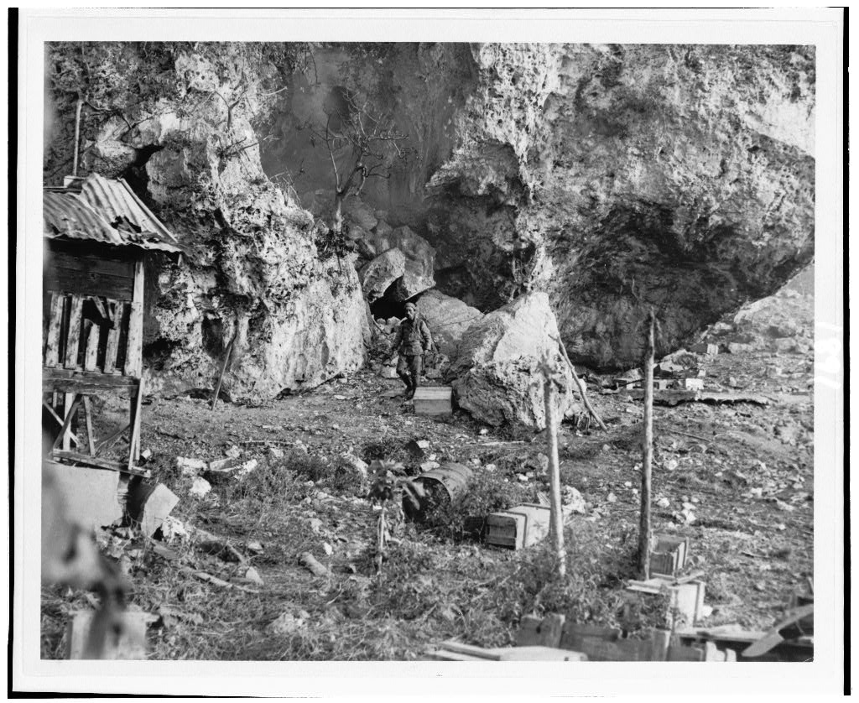
Which conflict is the photo from?
Pacific theater
Rugged/mountainous terrain, with soldier wearing a M98 service uniform

